Slide 1


CS677 Course Project
Parallel Probabilistic Data Sampling:
Implementation & Scaling Study
Course Instructors
Prof. Preeti Malakar
Prof. Soumya Dutta
Group Members
DASARI CHARITHAMBIKA
Divya Gupta
Om Shivam Verma
Palak Mishra
Siddharth Pathak

Slide 2

Contents
1
Introduction & Motivation
2
Problem Statement
3
Methodology
4
Simple Random Sampling
5
Value-based
Importance Sampling
6
Smoothness-based
Importance Sampling
7
Evaluation
8
Conclusion

Slide 3
Introduction
Sampling is a data analysis method involving the selection of a subset from a larger dataset.
Instead of analyzing every piece of data, sampling focuses on a representative group.
Efficiency, Cost-Effective, Inference, Bias Reduction
Motivation
Tech Challenge, Data Reduction, Feature Detection, Data Slimming Down, and Versatile Visualization

Slide 4
Problem Statement
Feature-based exploration in scientific datasets faces challenges, as existing methods do not effectively prioritize feature regions over non-feature regions.
Parallel implementation of existing sampling methods - Simple random sampling, Value-based Sampling, and Smoothness-based sampling.
Reconstruction based visualization and scaling of all implemented methods.

Slide 5
Methodology
Study & Sequential
Implementation of Algorithm
Visualizations
Paraview
Data reconstruction
from sampled data
Scaling Study
Number of processors
Number of bins
Sampling rates
Implement in Parallel
Message Passing Interface (MPI)
Evaluation
Visualization Toolkit (VTK)
Signal to Noise Ration (SNR)
Correlation Coefficient
numpy

Slide 6
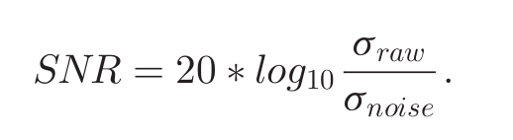
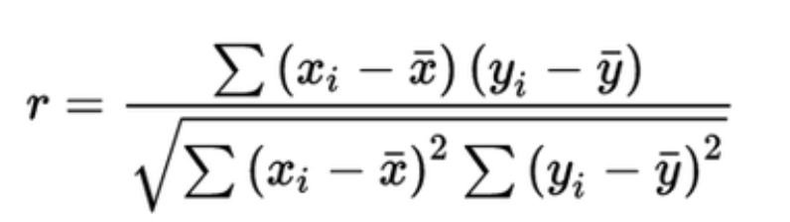
Methodology: Evaluation, Visualization
Signal-to-Noise Ratio
To estimate the quality of the reconstruction
Larger values indicate better reconstructions.
σ raw is the overall standard deviation of the original
data.
The quantity σ noise is the standard deviation of the error
of the reconstruction
Correlation coefficient Plot
Comparison of correlation coefficient across different sampling methods for three different datasets.

Slide 7
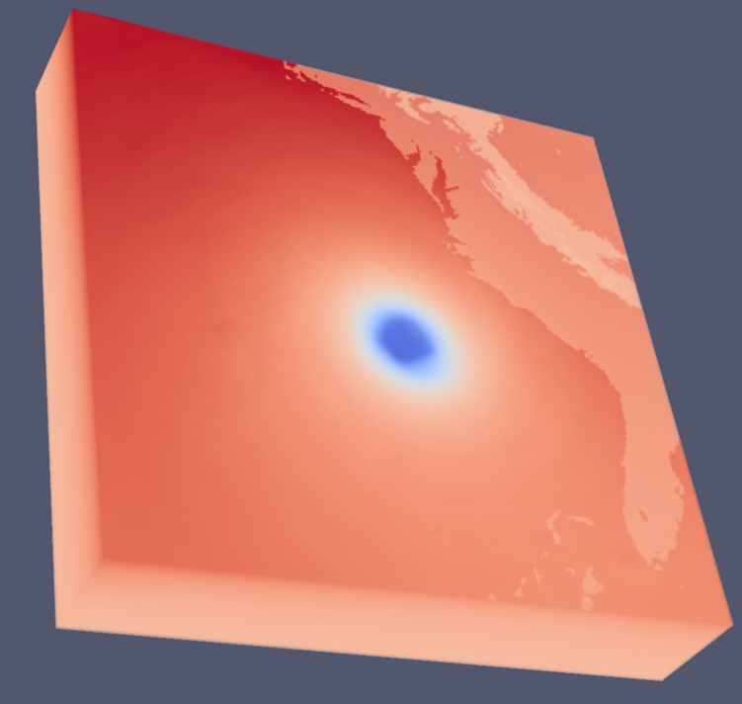
Datasets:
We are currently leveraging the Isabel dataset for the purpose of visualization and implementing parallelization techniques in our computational workflows.
We are using the two different dimensions of Isabel dataset.
“Small” dataset: 250 x 250 x 50
“Large” dimension: 750 x 750 x 150

Slide 8
Scaling Study
The KD lab computing nodes are used.
Each computing node runs 4 processes each.
Each combination of parameters was run 3-5 times, and the average time was taken
The computed times were:
Input/Output (I/O): Reading and writing to disk
Communication time: Time for scattering and gathering the data
Computing time: Time required to run computation on each node

Slide 9
1.Simple Random Sampling
Randomly drawing samples from unknown populations.
Methodology
Given a regular grid dataset and a user-given sampling fraction, η; a random number, r can be generated from a uniform distribution U~ unif(0, 1).
If r < η then this grid point will be accepted, ensuring each data point has an equal chance of getting selected.
Do not assign priority to any specific data value that might be of importance to the scientists.

Slide 10
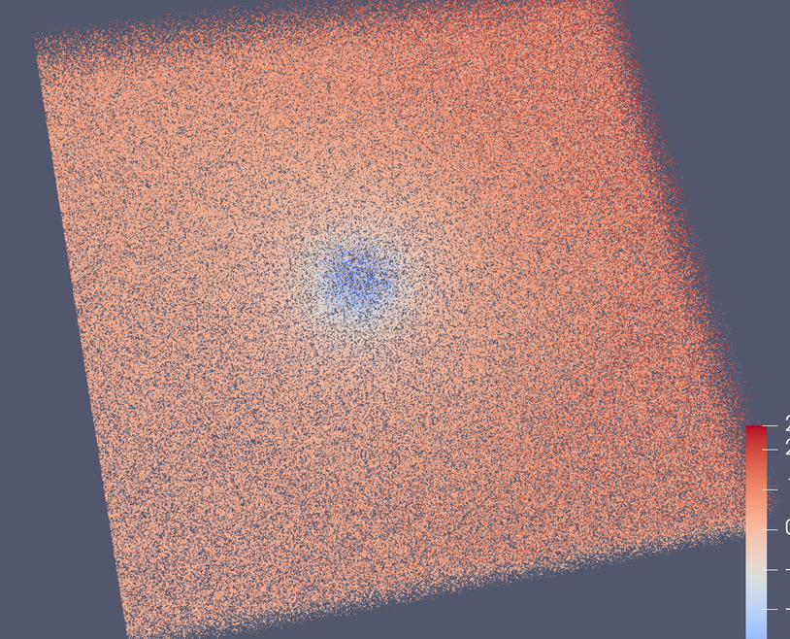
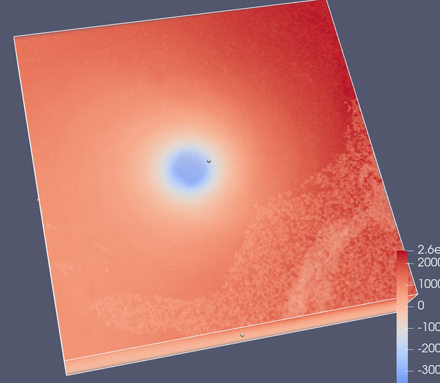
1.1 Visualisation
2% sampled
Original Dataset
Reconstructed in Paraview
Sampled Data in Paraview

Slide 11
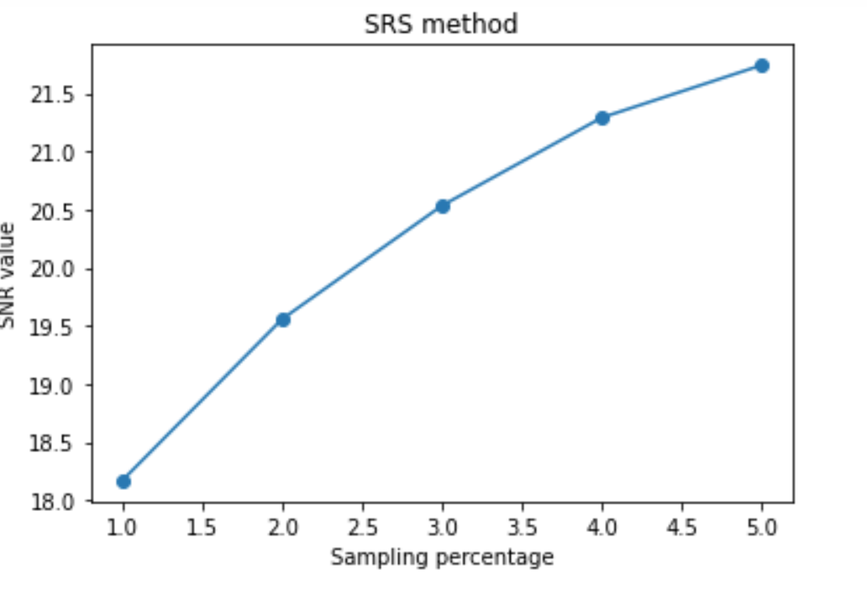
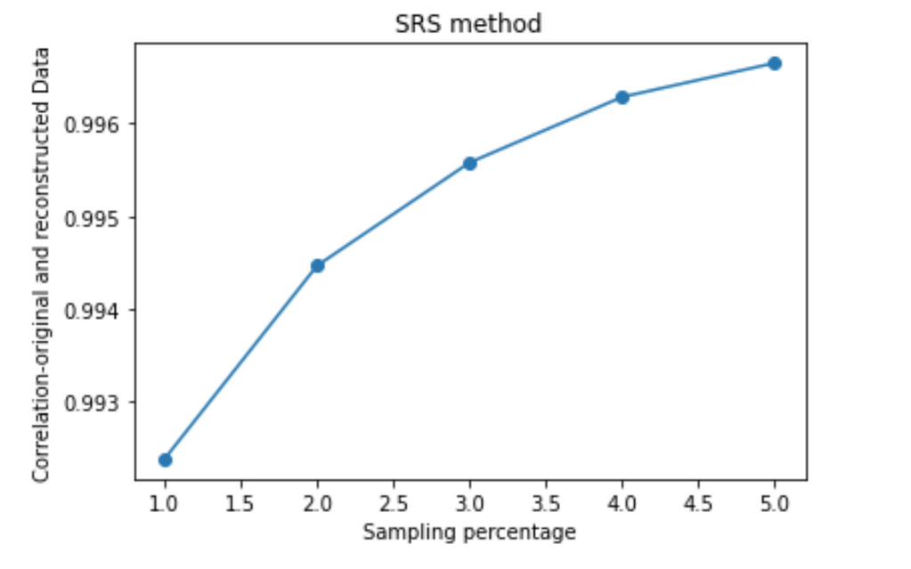
1.2 Evaluation
Correlation coefficient between original and Reconstructed datasets.a
SNR-Sampling Rate
Correlation-Sampling Rate

Slide 12
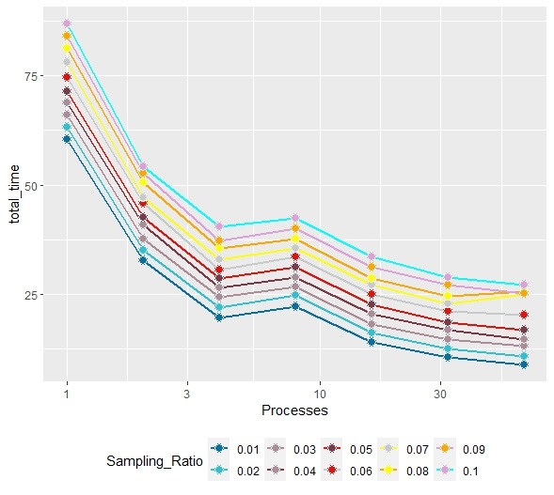
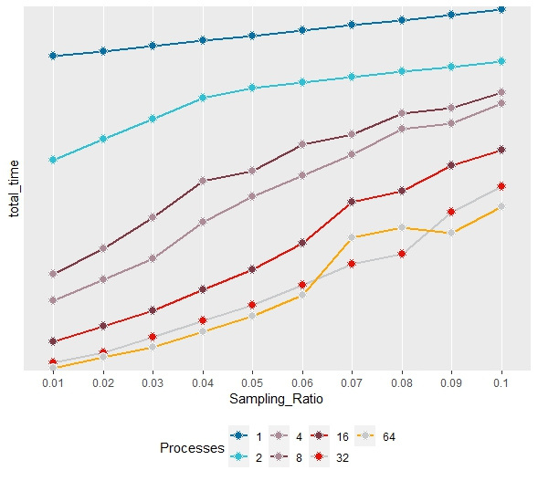
1.3 Scaling
Time - #Processes
Time - Sampling Rates

Slide 13
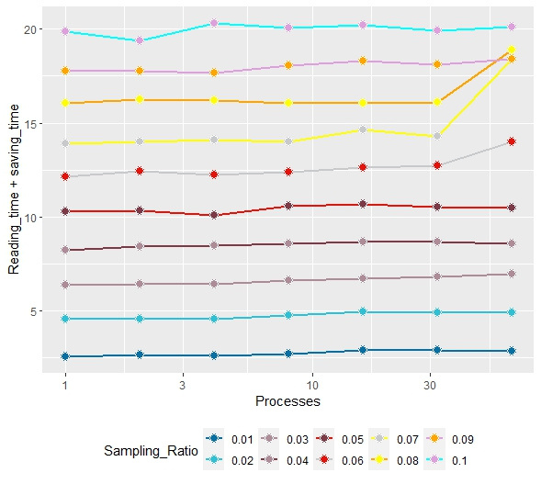
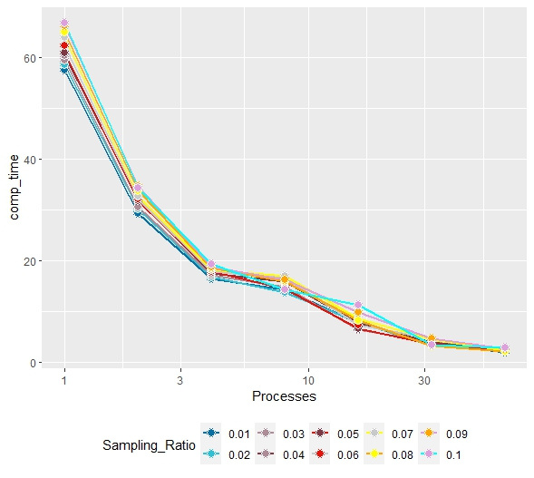
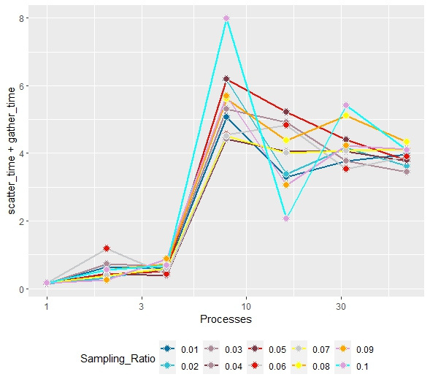
Reason of Sharp Kink in Total Time from going to 4-5 Processes
Input/Output - # processes
Computing time - # processes
Communication time - # processes

Slide 14
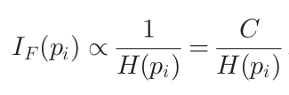
2. Value-based Importance Sampling
Method
In parallel
Creating value-based histogram
Read data and Scatterv to all nodes
Calculate of Importance function
such that sparse values are sampled more, i.e.
Allreduce the min and max values
Count frequencies in each bin
Allreduce to get global histogram
Create the importance funtion
Sample points at each node, as coordinates and values
Importance function:
Probability with which a point is sampled
Gatherv to collect sampled points
Sampled according to importance function
Write the points to a vtp file

Slide 15
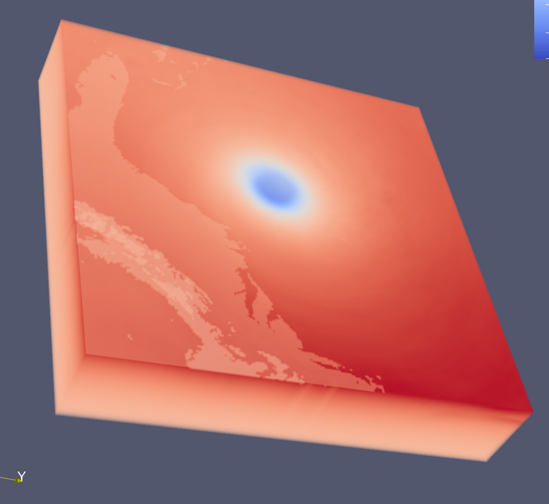
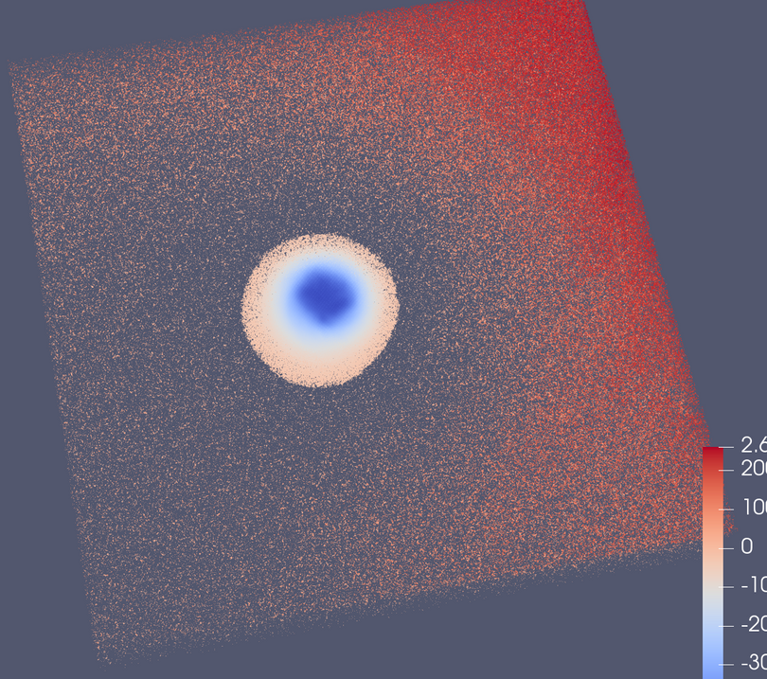
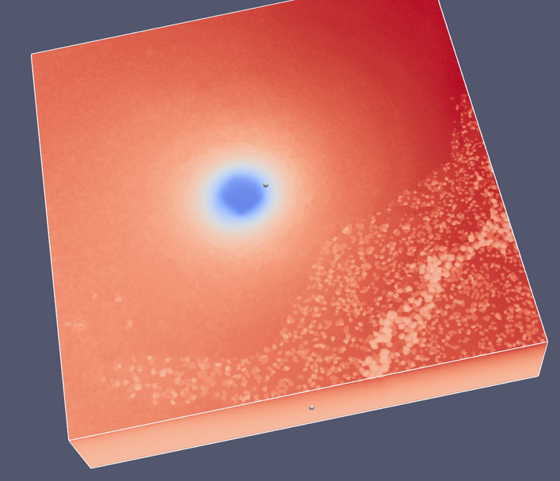
2.1 Visualisation
2% sampled
Sampled data in paraview
Reconstructed in Paraview
Original dataset

Slide 16
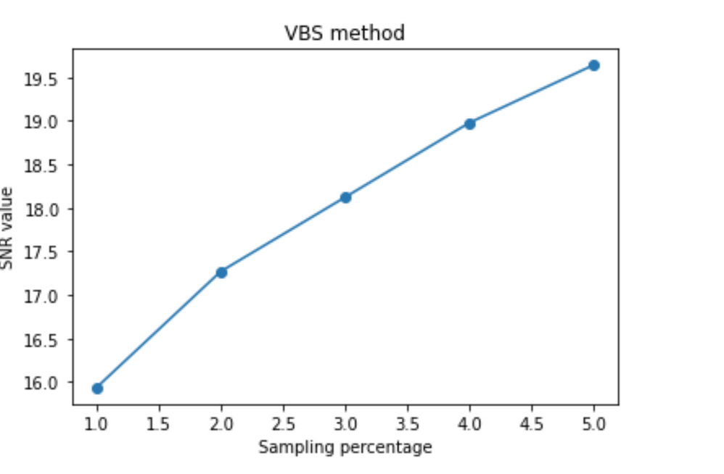
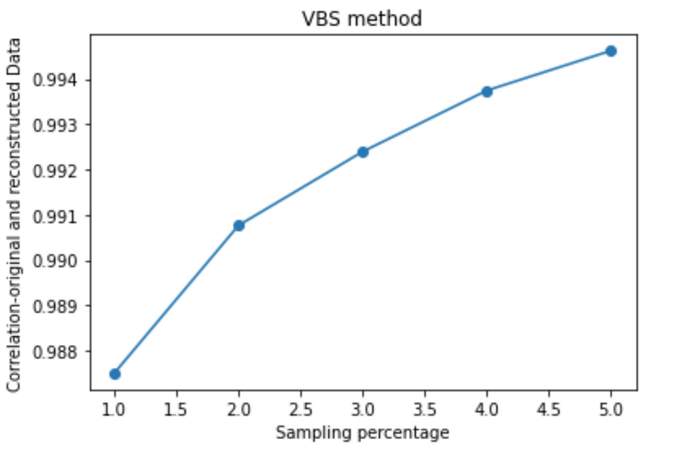
2.2 Evaluation
Correlation coefficient between original and Reconstructed datasets.a
SNR-sampling rate
Correlation-sampling rate

Slide 17
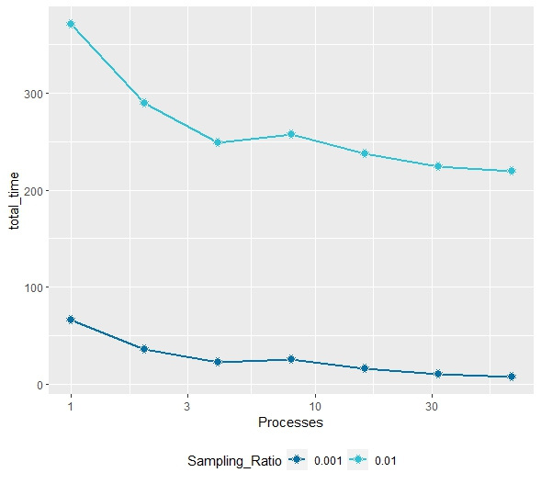
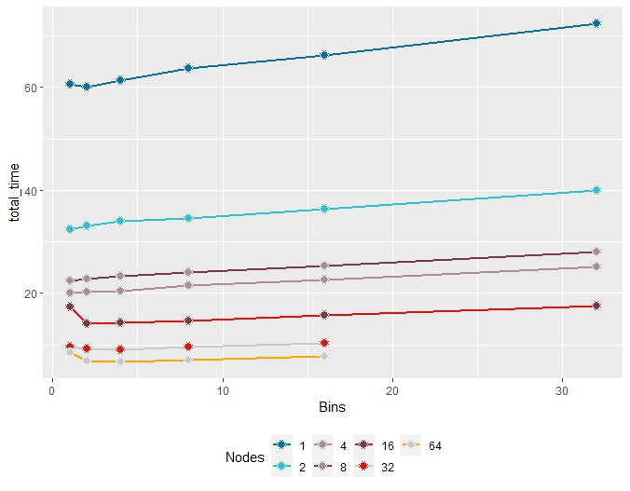
2.3 Scaling
Time-#processes
Time-#bins

Slide 18
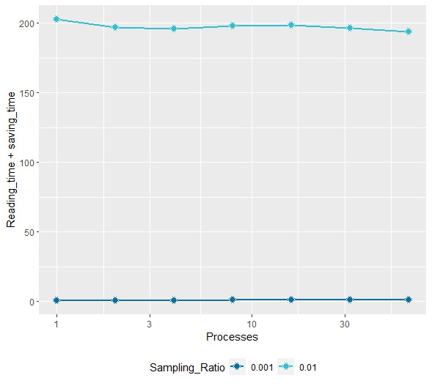
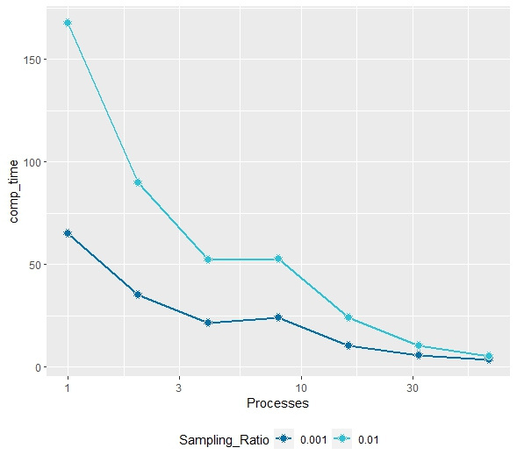
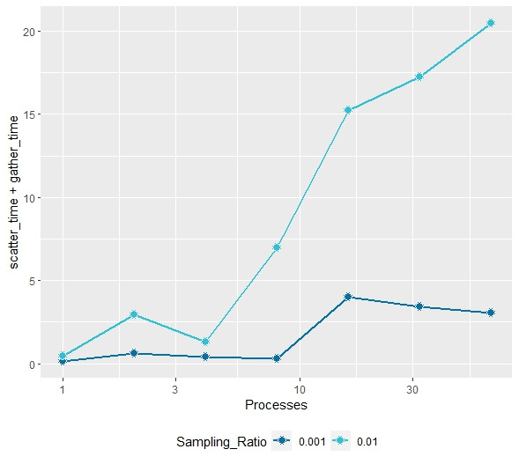
Input/Output - # processes
Computing time - # processes
Communication time - # processes

Slide 19
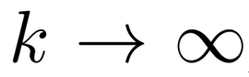
3. Smoothness-based Importance Sampling
Method
In parallel
Read data and Scatterv to all nodes
Calculate gradients
Calculate gradient at each node
Create gradient-based histogram
allreduce the min and max values
Count frequencies in each bin
Calculate of Importance function such that highest gradients are sample most, i.e.
Allreduce to get global histogram
Create the importance funtion
Sample points at each node, as coordinates and values
Gatherv to collect sampled points
Sampled according to importance function
Write the points to a vtp file

Slide 20
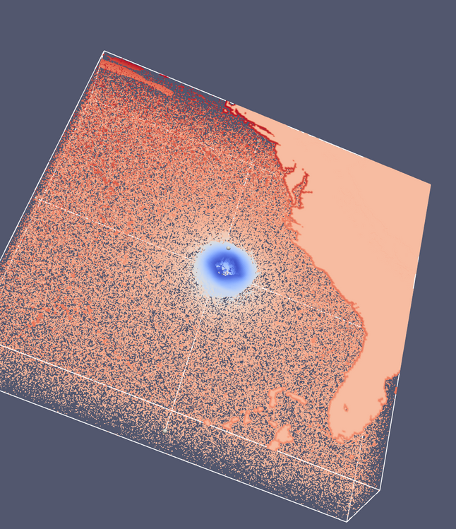
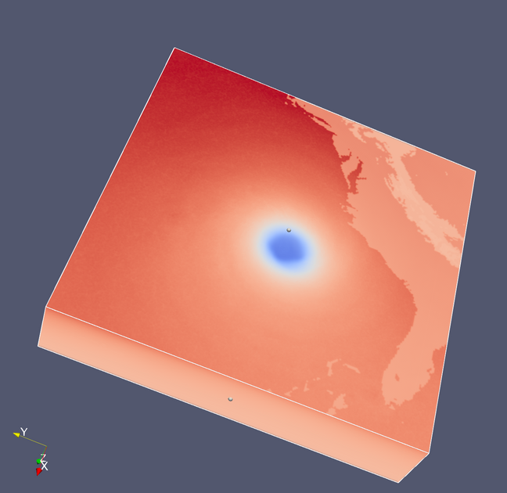
3.1 Visualisation
2% sampled
Sampled data in paraview
Reconstructed in Paraview
Original dataset

Slide 21
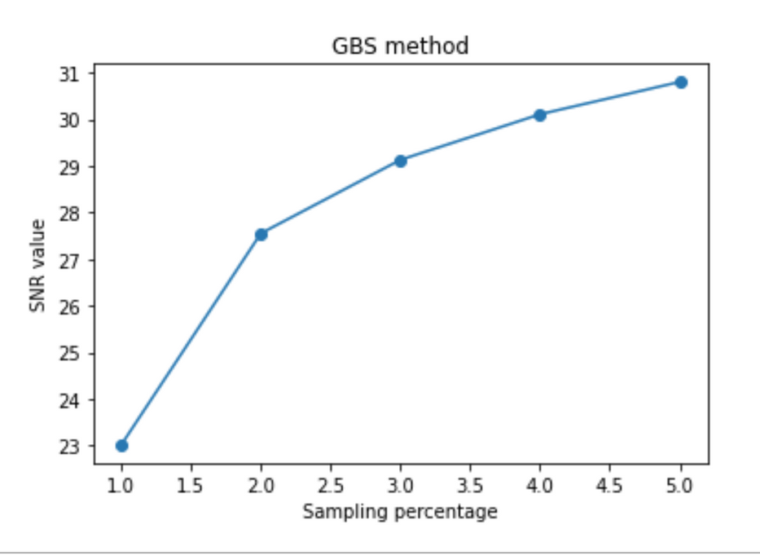
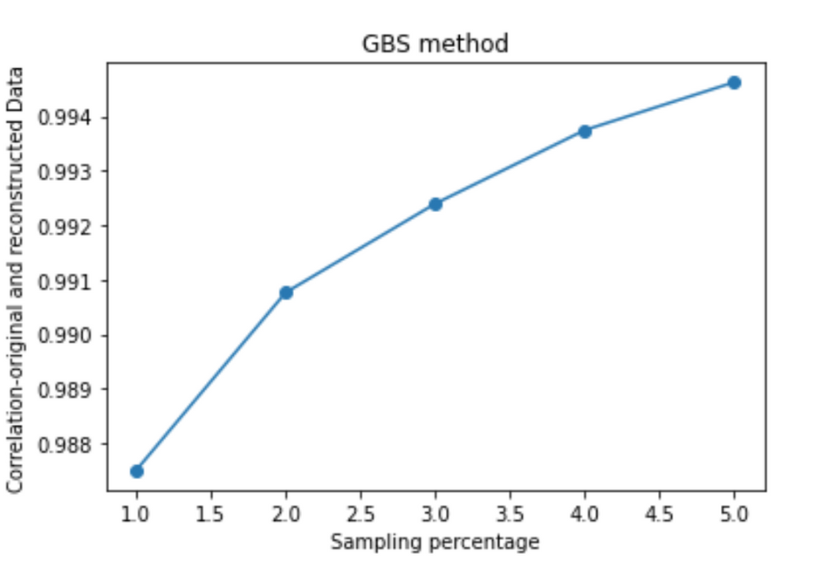
3.2 Evaluation
SNR-sampling rate
Correlation-sampling rate

Slide 22
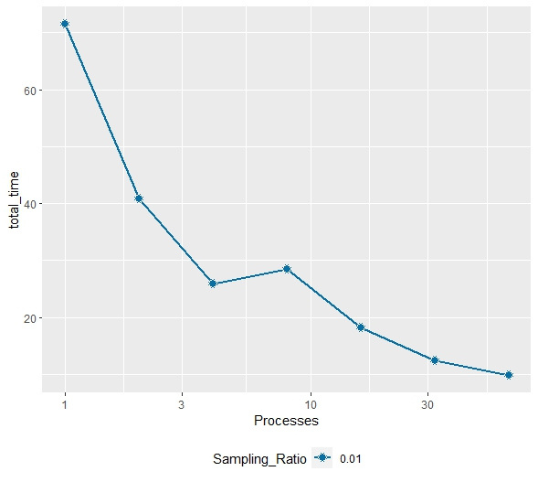
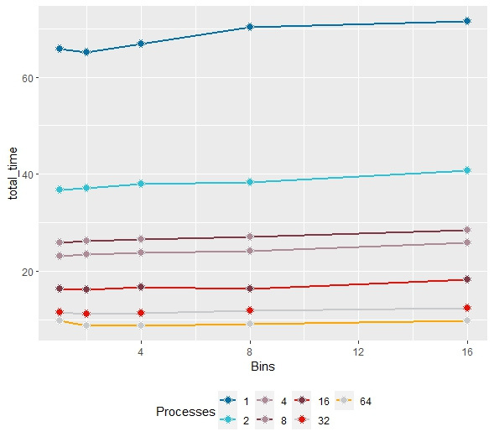
3.3 Scaling
Time-#processes
Time-#bins

Slide 23
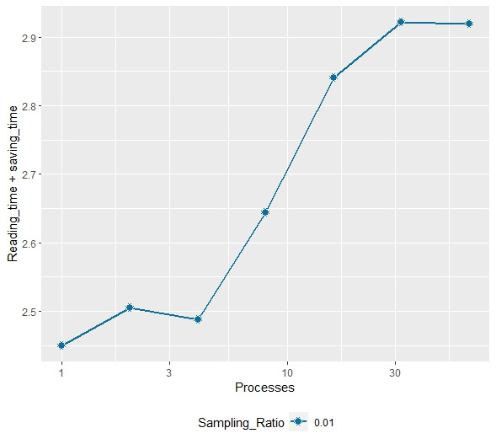
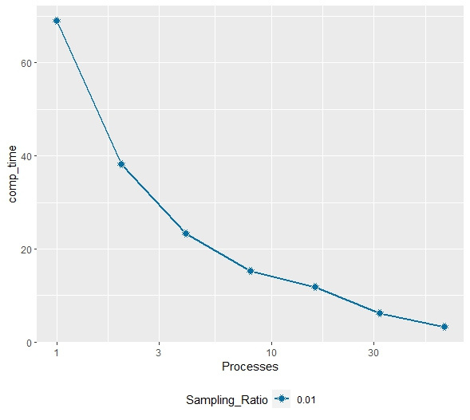
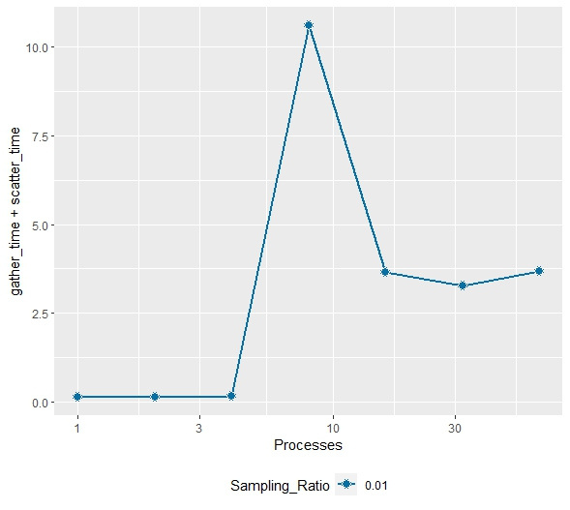
Input/Output - # processors
Computing time - # processors
Communication time - # processors

Slide 24
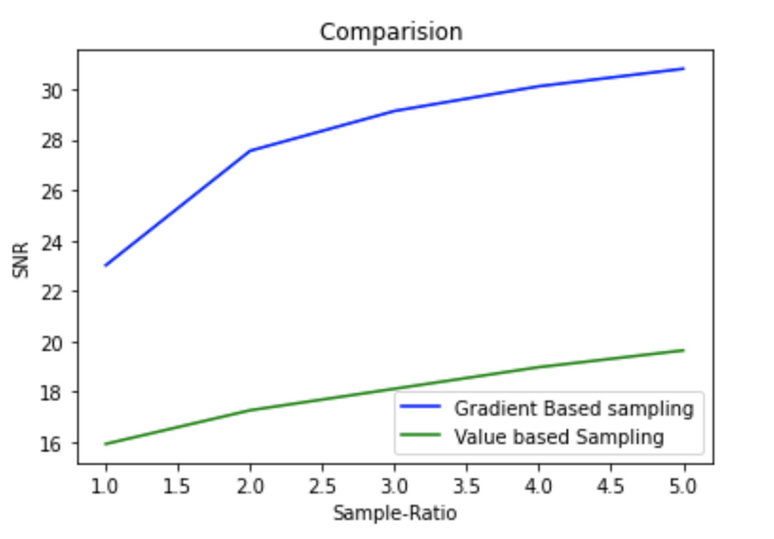
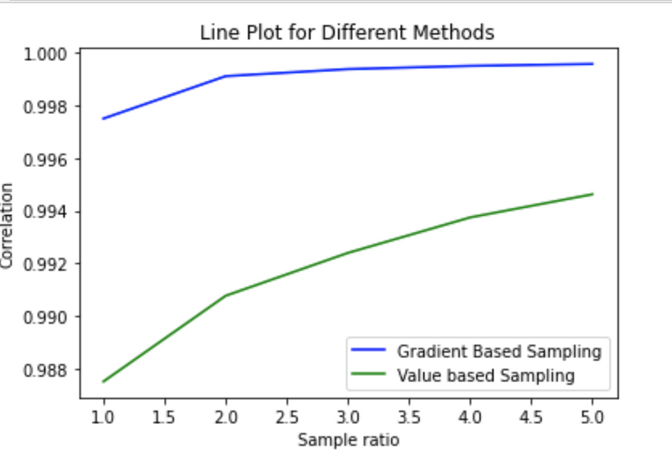
Evaluation
Signal-to-noise ratio (SNR)
Comparison of SNR across different sampling methods for varying sampling ratios.
It can be observed that for a given sampling rate, our proposed method generally performs better
Correlation Plot
Comparison of correlation coefficient across different sampling methods for various sampling ratio

Slide 25

Conclusion
We have implemented sampling techniques
Simple random sampling
Value-based importance sampling
Smoothness-based Importance Sampling
2. We have utilized mpi4py for parallelization, employed to distribute the computational workload across multiple nodes or processors
3. We have used linear interpolation based reconstruction-based visualization
4. We have used these evaluation metrics to compare the existing methods to our method
Signal to Noise Ratio (SNR)
Correlation Coefficient

Slide 26
Conclusion
5. Implementation Tools:
Employed a combination of programming languages and libraries suitable for implementing the sampling techniques, mpi4py, and visualization algorithms
Ensured compatibility and optimization for parallel computing using mpi4py
6. Objective:
The overarching goal was to enhance the efficiency and accuracy of data sampling and visualization through the integration of diverse sampling techniques and parallelization strategies.

Slide 27
Work distribution
Student’s Name | Work
Dasari Charithambika | Reconstruction based visualization, Evaluation,Report, PPT
Divya Gupta | Reconstruction based visualization, Evaluation, Report, PPT
Om Shivam Verma | Correction in our VBS Implementation, Parallelisation using MPI, VTK file handling, Report, PPT
Palak Mishra | Implementation of Sampling Algorithms in series, Report, PPT
Siddharth Pathak | Scaling study, Report, PPT

Slide 28
References:
https://ieeexplore.ieee.org/document/9130956t
https://mpi4py.readthedocs.io/
https://examples.vtk.org/site/Python/

Slide 29

THANK YOU SO MUCH!
thank you so much

